Slide 1

Project: SQL Data Analysis & Visualization with Power BI for FDA (PART 1 – SQL QUERIES)
ASSIGNMENT : 03
ABADS BATCH 12

Slide 2
Introduction:
The U.S. Food and Drug Administration (FDA) is a federal agency responsible for safeguarding public health in the United States. It oversees various areas, including food safety, pharmaceuticals, medical devices, cosmetics, tobacco, and veterinary products. The FDA evaluates the safety and efficacy of drugs, biological products, and medical devices, conducts inspections, and enforces regulations. It also regulates food production and distribution, conducts research, provides public health education, and monitors and responds to emerging health risks. The FDA's mission is to protect and promote public health by ensuring the safety and effectiveness of a wide range of products and substances. iVision is collaborating with FDA to perform Data analysis on FDA’s dataset. FDA has provided iVision with SQL script of their dataset. As an analyst at iVision your role is to create informative reports by conducting a thorough analysis of the data using powerful tools like MySQL and Power BI.

Slide 3
define SQL ?
MySQL is a widely used relational database management system (RDBMS).
MySQL is free and open-source.
MySQL is ideal for both small and large applications.
Start learning MySQL now »

Slide 4
SQL : Features
SQL can execute queries against a database
SQL can retrieve data from a database
SQL can insert records in a database
SQL can update records in a database
SQL can delete records from a database
SQL can create new databases
SQL can create new tables in a database
SQL can create stored procedures in a database
SQL can create views in a database
SQL can set permissions on tables, procedures, and views

Slide 5
Software / Tools:
MySQL
Power BI

Slide 6
Project Objectives : Part - 1 SQL Queries:
Task 1: Identifying Approval Trends
1. Determine the number of drugs approved each year and provide insights into the yearly trends.
2. Identify the top three years that got the highest and lowest approvals, in descending and ascending order, respectively.
3. Explore approval trends over the years based on sponsors.
4. Rank sponsors based on the total number of approvals they received each year between 1939 and 1960.

Slide 7
Project Objectives: SQL PART
Task 2: Segmentation Analysis Based on Drug MarketingStatus
1. Group products based on MarketingStatus. Provide meaningful insights into the segmentation patterns.
2. Calculate the total number of applications for each MarketingStatus year-wise after the year 2010.
3. Identify the top MarketingStatus with the maximum number of applications and analyze its trend over time

Slide 8
Project Objectives :SQL PART
Task 3: Analyzing Product
1. Categorize Products by dosage form and analyze their distribution.
2. Calculate the total number of approvals for each dosage form and identify the most successful forms.
3. Investigate yearly trends related to successful forms
Task 4: Exploring Therapeutic Classes and Approval Trends
1. Analyze drug approvals based on therapeutic evaluation code (TE_Code).
2. Determine the therapeutic evaluation code (TE_Code) with the highest number of Approvals in each year.

Slide 9
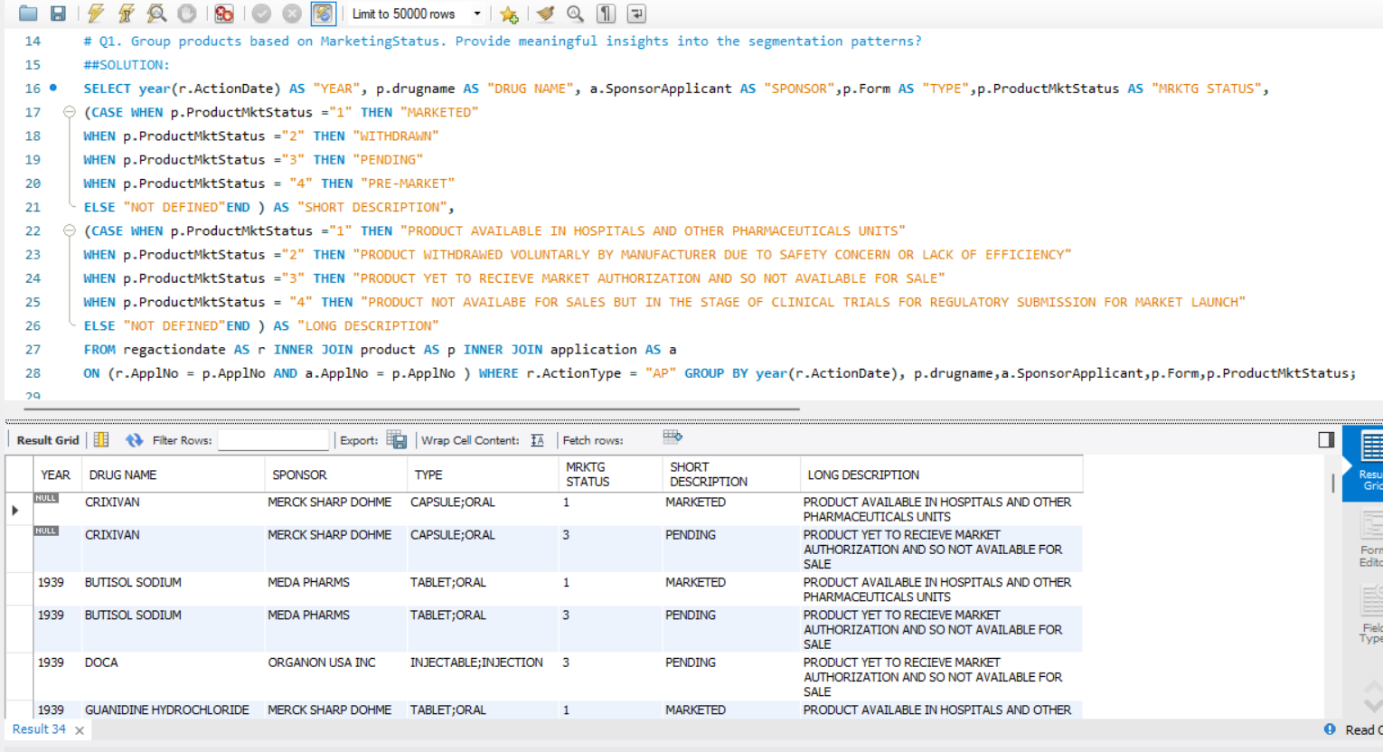
Task 1: Identifying Approval Trends Q1.)Determine the number of drugs approved each year and provide insights into the yearly trends.

Slide 10
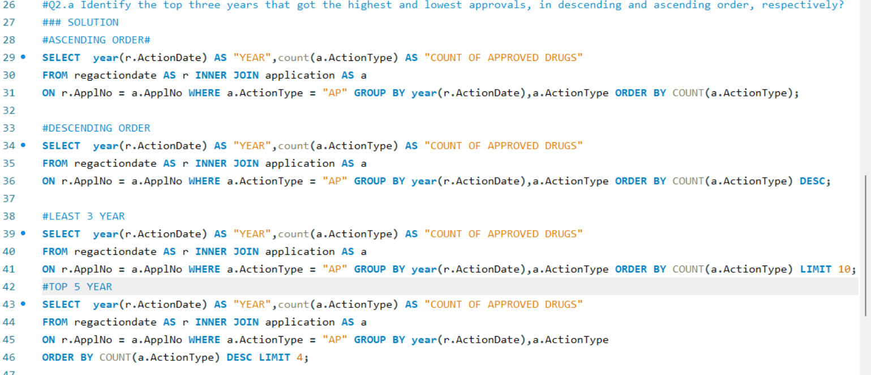
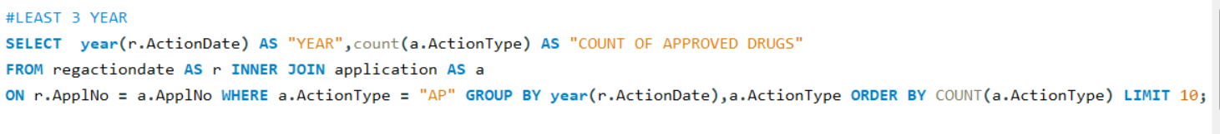
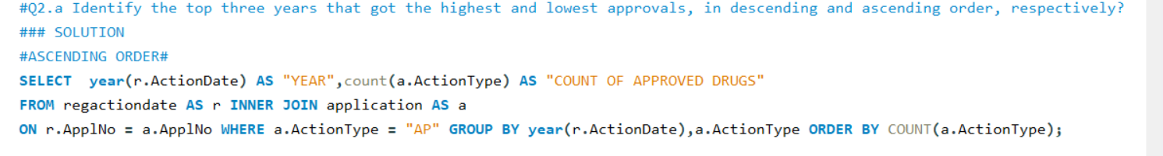
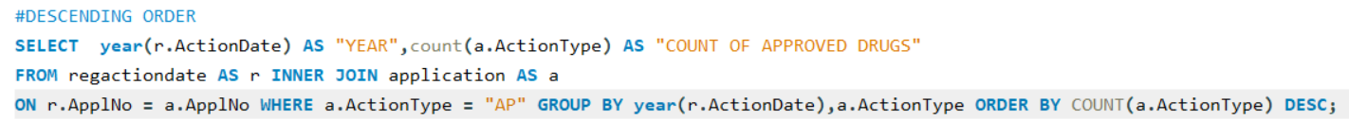
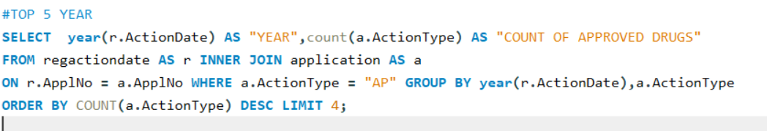
Q2). Identify the top three years that got the highest and lowest approvals, in descending and ascending order, respectively?

Slide 11
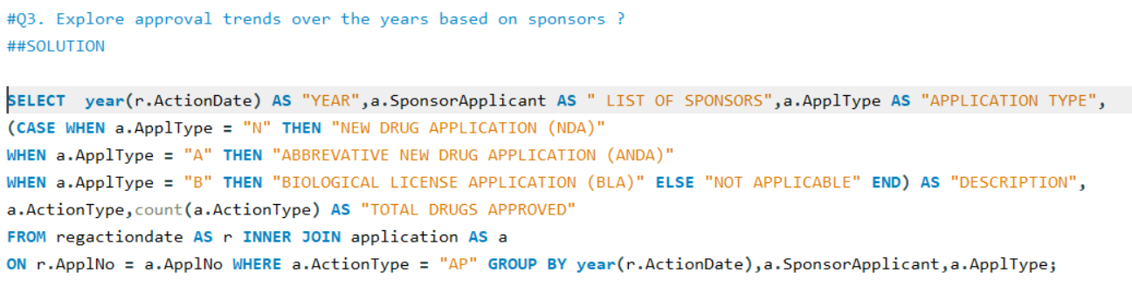
Q3) Explore approval trends over the years based on sponsors?

Slide 12
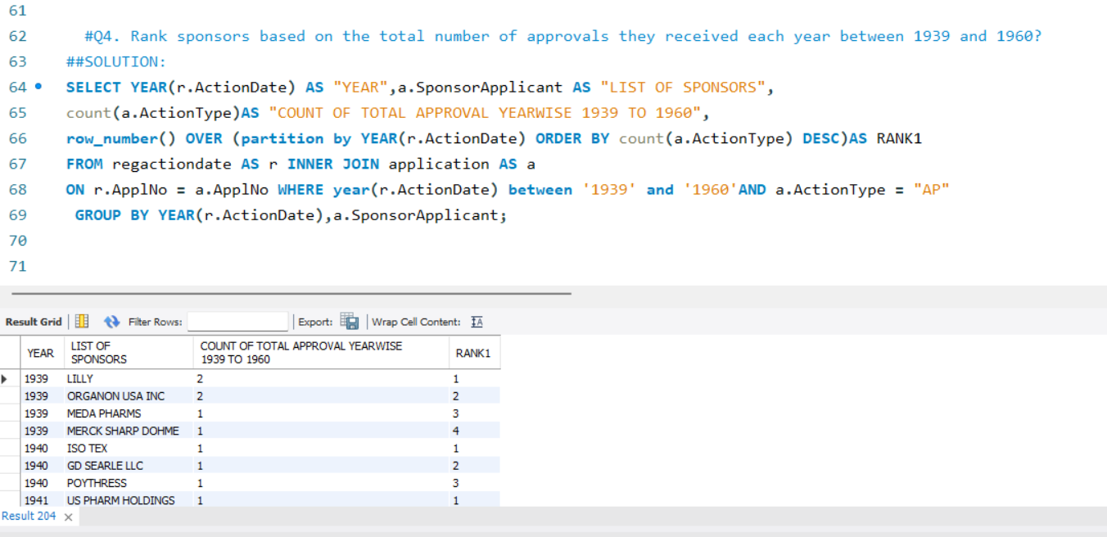
Q4) Rank sponsors based on the total number of approvals they received each year between 1939 and 1960?

Slide 13
Task 2: Segmentation Analysis Based on Drug Marketing Status Q1). Group products based on Marketing Status. Provide meaningful insights into the segmentation patterns?

Slide 14
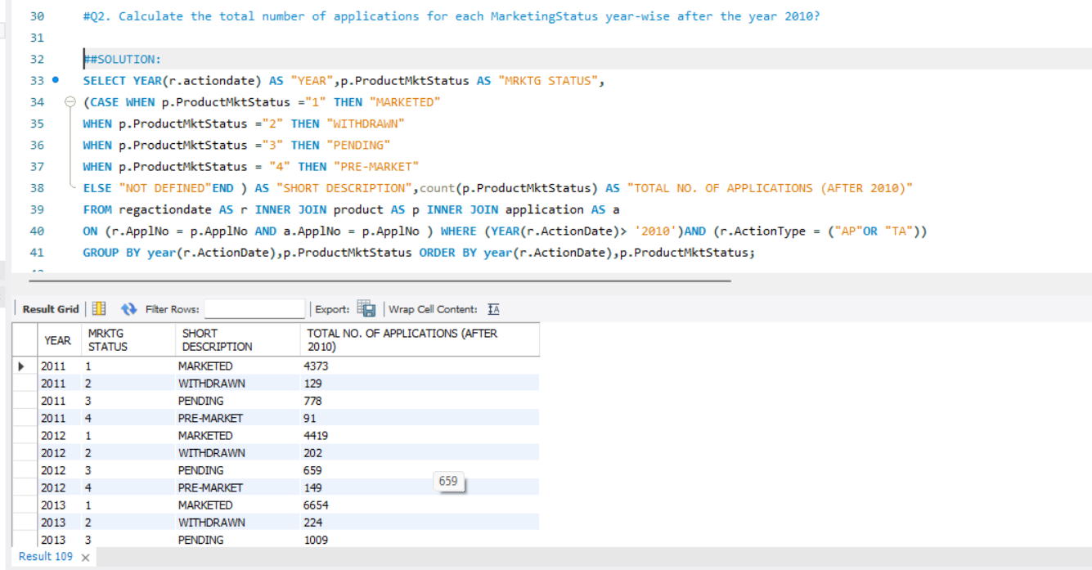
Q2.) Calculate the total number of applications for each Marketing Status year-wise after the year 2010?

Slide 15
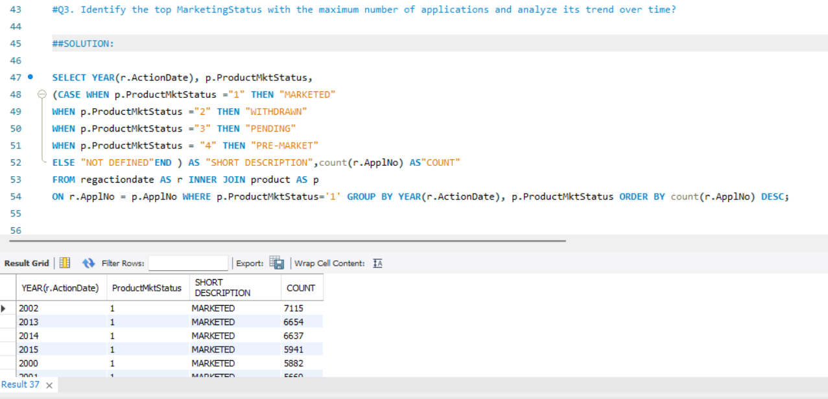
Q3.) Identify the top MarketingStatus with the maximum number of applications and analyze its trend over time ?

Slide 16
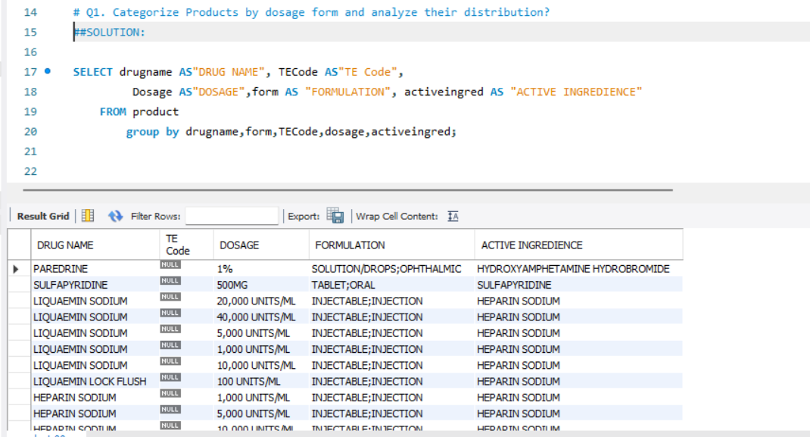
Task 3: Analysing Product Q1.) Categorize Products by dosage form and analyze their distribution

Slide 17
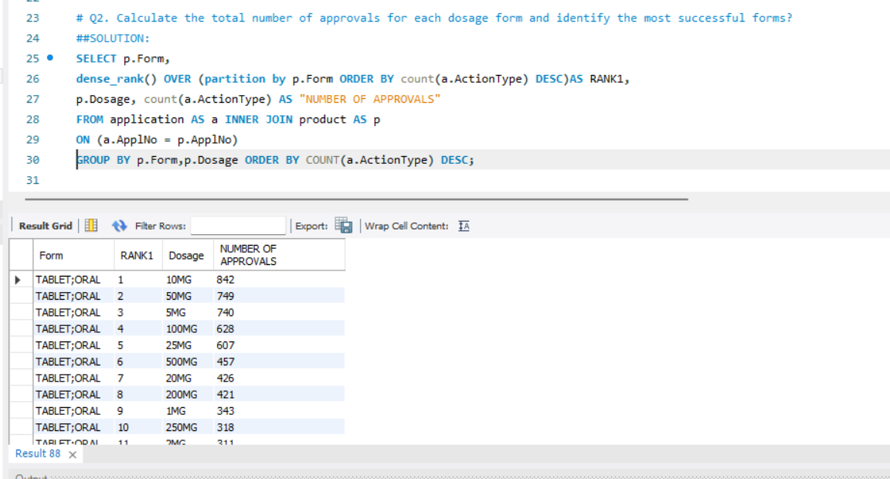
Q2.) Calculate the total number of approvals for each dosage form and identify the most successful forms?

Slide 18
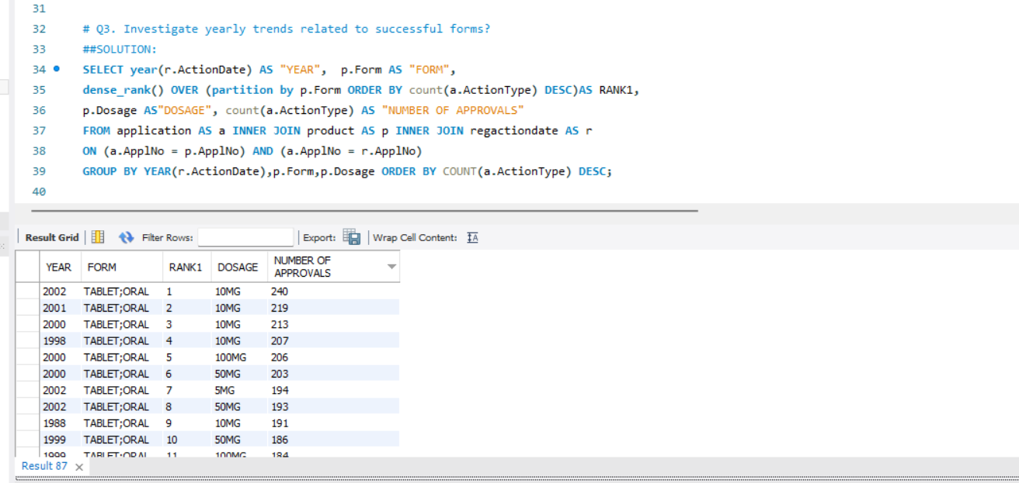
Q3.) Investigate yearly trends related to successful forms?

Slide 19
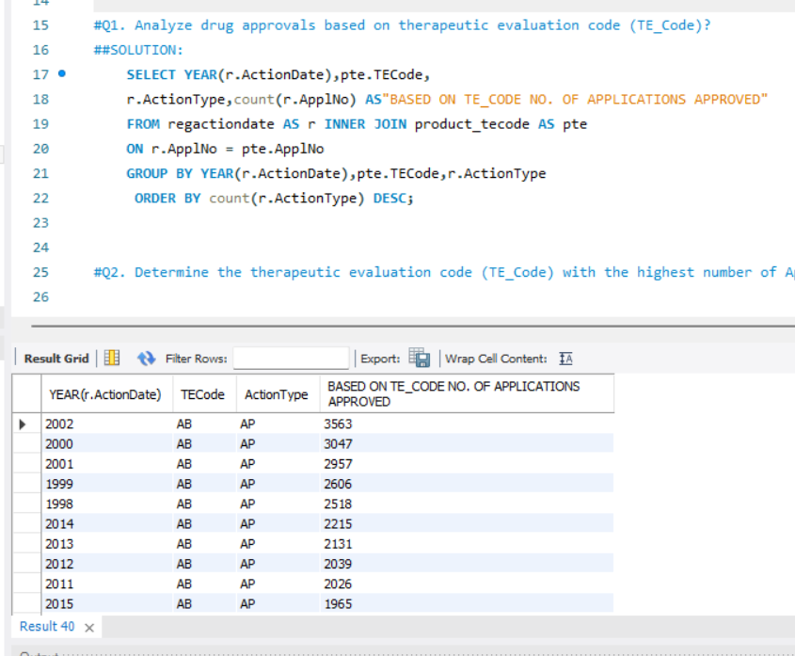
Task 4: Exploring Therapeutic Classes and Approval Trends Q1.) Analyze drug approvals based on therapeutic evaluation code (TE_Code).

Slide 20
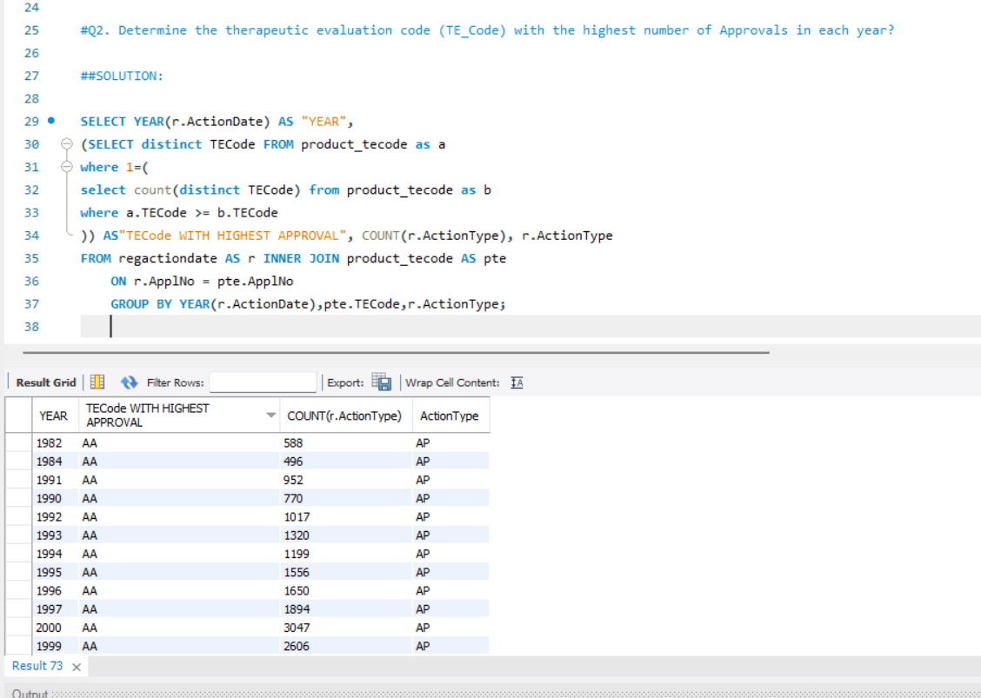
Q2.) Determine the therapeutic evaluation code (TE_Code) with the highest number of Approvals in each year?

Slide 21
Thank You

